Slide 1
A comparison of Time Series Classification Algorithms based on their ability to learn in an Early Classification Context Ismail Wahba 10 June 2021

Slide 2
Agenda
Introduction
Motivation
Research Questions
Data Sets
Methodology
Results
Conclusion
Future Work
Q&A

Slide 3
Introduction
Time Series field has been thriving in the last decade
Personal Gadgets
Smart home sensors
Time Series Classification (TSC)
Accuracy
Space and Time Complexity
Full data is available
Early Time Series Classification (eTSC)
Accuracy and Earliness
Time is important, classify as early as possible

Slide 4
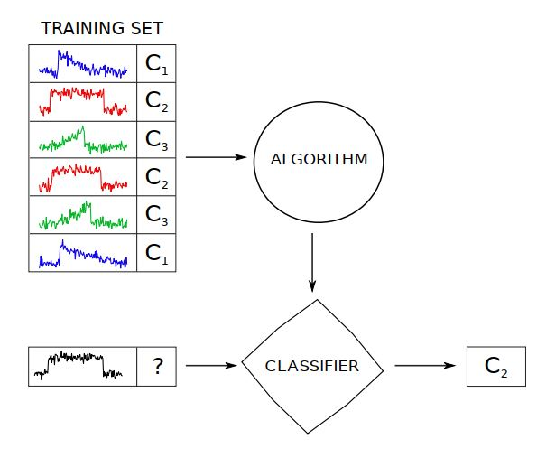
Introduction
Time Series field has been thriving in the last decade
Personal Gadgets
Smart home sensors
Time Series Classification (TSC)
Accuracy
Space and Time Complexity
Full data is available
Early Time Series Classification (eTSC)
Accuracy and Earliness
Time is important, classify as early as possible
Time Series Classification [12]

Slide 5
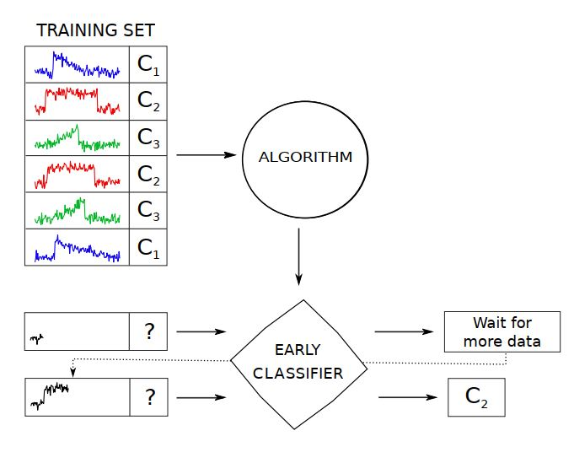
Introduction
Time Series field has been thriving in the last decade
Personal Gadgets
Smart home sensors
Time Series Classification (TSC)
Accuracy
Space and Time Complexity
Full data is available
Early Time Series Classification (eTSC)
Accuracy and Earliness
Time is important, classify as early as possible
Early Time Series Classification [12]

Slide 6
Motivation
Study of the relationship between TSC and eTSC, by examining the possibility of adjusting the former to deal with earliness.
What if we create an early context for TSCAs to operate in
Competent TSCAs that attain high accuracy and earliness can be used for early classification purposes
For example: audiological examinations are strenuous for patients and shortening them can help decrease discomfort

Slide 7
Research Questions
Research Question 1 (RQ1): How to adapt existing TS classification workflow for the early TS scenario ?
Research Question 2 (RQ2): How to evaluate the classifiers in the early TSC context, combining performance and earliness ?
Research Question 3 (RQ3): How to evaluate the proposed solution ?

Slide 8
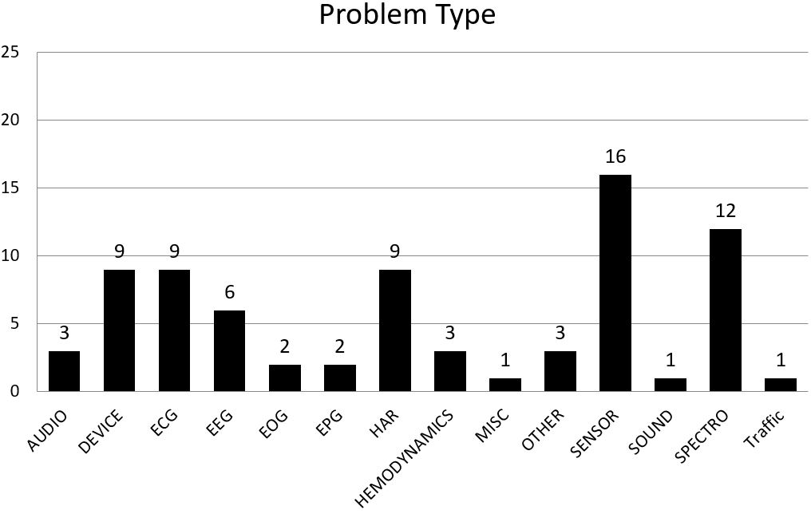
Data Sets
UCR univariate time series data archive [13]
UEA multivariate time series data archive [14]
Total of 77 data sets
55 univariate
22 multivariate

Slide 9
Data Sets
UCR univariate time series data archive [13]
UEA multivariate time series data archive [14]
Data Sets with real life time series
Instances has same length
No missing values
Total of 77 data sets
55 univariate
22 multivariate

Slide 10
Related Work
Time Series Classification Algorithms Groups:
Distance-based (Whole) time series
Phase dependant (Interval-based)
Phase independant (Shapelets)
Dictionary based (BOP)
Ensembles
Deep Learning

Slide 11
Related Work
Other frameworks to compare TSCAs over multiple data sets
The great bake off [1]
18 algorithms
85 univariate data sets (UCR)
Deep Learning for time series classification [4]
9 DL algorithms
85 univariate data sets (UCR)
Multivariate bake off [5]
16 multivariate algorithms
30 multivariate data sets (UEA)

Slide 12
Methodology
Early Classification Context
Algorithms used
Proposed solution

Slide 13
Methodology - Context
What is Early Classification Context ?
Train algorithms on labeled but trimmed time series instances
Classify full length instances
Investigate if algorithm can learn about the problem without waiting for full data
Compare the performance if learned on full length data

Slide 14
Methodology - Algorithms
Distance based: Proximity Forest [7], Move-Split-Merge (MSM) [6]
Interval based: Time Series Forest (TSF) [8]
Shapelets: Learned Shapelet (LS) [10], Shapelet Transform (ST) [9]
Dictionary based: WEASEL [3], Bag of SFA Symbols (BOSS) [11]
Deep learning: Inception-Time [2]
Classical baselines: 1-NN ED & 1-NN DTW
Baseline (Dummy) Classifier (majority class)
Column Ensembling for multivariate data sets

Slide 15
Methodology – Framework
Research Question 1 (RQ1): How to adapt existing TS classification workflow for the early TS scenario ?
Framework implementing the early classification context
Testbed for comparing TSCAs in an early classification context
Recommender to suggest models for unseen data sets

Slide 16
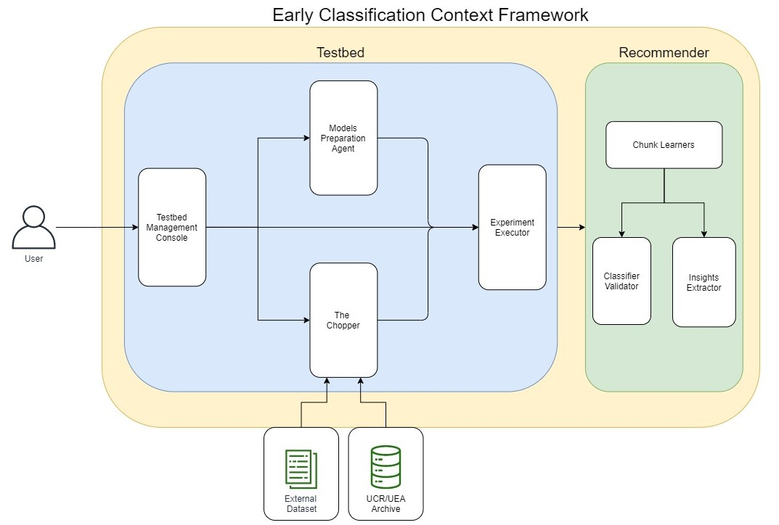
Methodology – Framework

Slide 17
Methodology – Framework
Framework implementing the early classification context
Testbed for comparing TSCAs in an early classification context
Recommender to suggest models for unseen data sets
Testbed
Cutting time series into 10 chunks (increments of 10%)
Use evaluation metric combining accuray and earliness as performance measure
Use performance of whole time series as baseline
Recommender:
Learn on performance results from testbed
Assess classifiers as good and bad for each data set

Slide 18
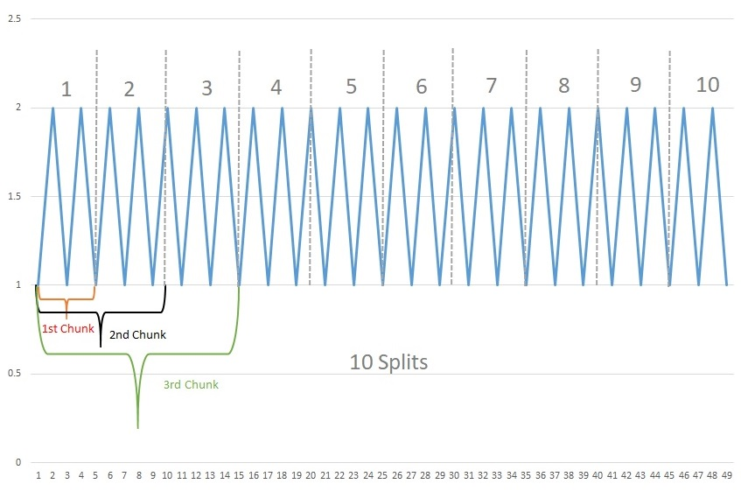
Methodology - The Chopper

Slide 19
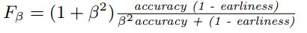
Methodology – Framework
Research Question 2 (RQ2): How to evaluate the classifiers in the early TSC context, combining performance and earliness ?
eTSC solution:
Harmonic mean of Accuracy and Earliness
Beta = 1, accuracy and earliness are equally important

Slide 20
Methodology – Framework
Research Question 2 (RQ2): How to evaluate the classifiers in the early TSC context, combining performance and earliness ?
Our Solution:
Performance measure: Balanced Accuracy
Earliness: Revealed % of data (depends on chunk)
Beta = 0.5, accuracy is twice as important as earliness

Slide 21
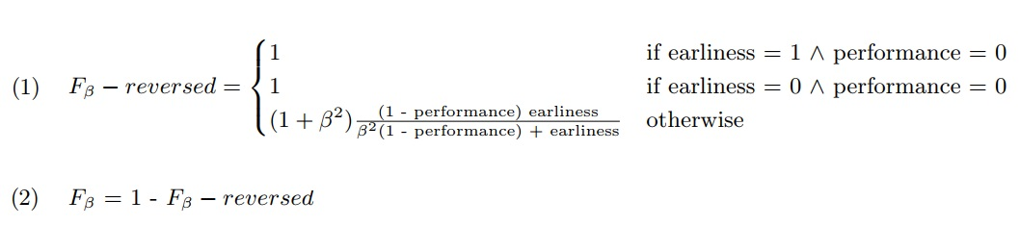
Methodology – Framework
Research Question 2 (RQ2): How to evaluate the classifiers in the early TSC context, combining performance and earliness ?

Slide 22
Methodology – Framework
Research Question 3 (RQ3): How to evaluate the proposed solution ?
Train a Recommender
Learns on the performance of classifiers per data set per chunk
Suggests good performing classifiers for unseen data sets
Provides insights about the important features

Slide 23
Methodology – Framework
Random Forest Regressor per chunk
Predict F-scores for all classifiers and majority class baseline
Good Classifiers better than baseline

Slide 24
Methodology – Framework
Random Forest Regressor per chunk
Predict F-scores for all classifiers and majority class baseline
Good Classifiers better than baseline

Slide 25
Experiments
Testbed
10 classifiers on 77 data sets
10 splits
1st (10%), 2nd (20%), 3rd (30%) and 10th (100%) chunks
Recommender
Performance results from testbed
4 random forest regressors
50 runs with resampling
15 data sets for testing

Slide 26
Results
Results for Testbed
Within same classifier (across chunks)
Across different classifiers (on same chunk)
Data characteristics in relation to performance
Runtime performance
Results for Recommender
Preditcting F-scores
Final Recommendation
Features contribution to final prediction

Slide 27
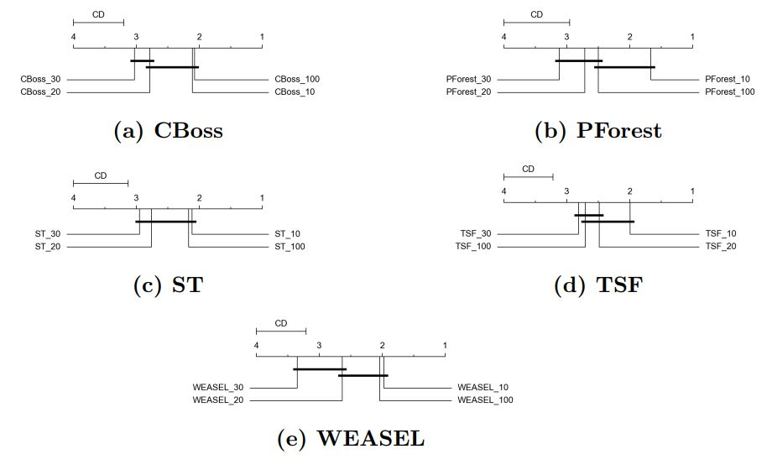
Testbed Results – Within Classifier

Slide 28
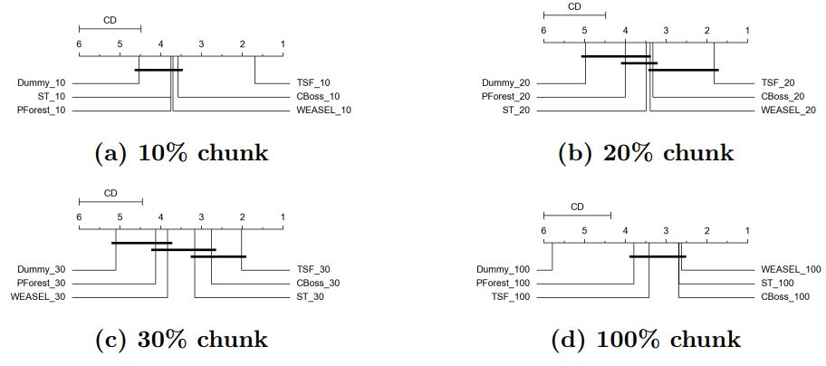
Testbed Results – Across Classifiers

Slide 29
Testbed Results
TSF, WEASEL, CBOSS, ST and Pforest worked in the early context
All 5 classifiers finished on 36 common data sets
KNN-ED and Inception Time failed to handle the early classification context
LS & MSM results lower than the published results
KNN-DTW failed due to code failure

Slide 30
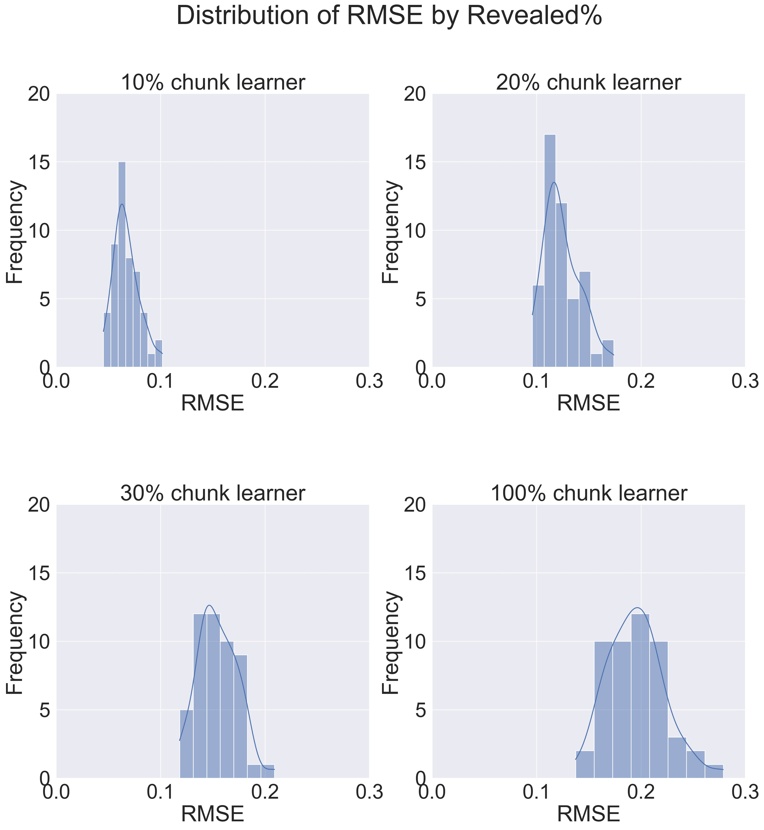
Recommender Results – Predicting F-Scores
Revealed% | Avg MAE | Avg RMSE
10 | 4.82 | 6.71
20 | 9.57 | 12.42
30 | 12.03 | 15.46
100 | 15.58 | 19.52
Overall performance of chunk learners in predicting actual F-scores over 50 runs

Slide 31
Recommender Results – Final Recommendation
High Accuracy and Recall
Relatively lower precision on lower chunks
Baseline classifier plays an important role in determining the results
Revealed % | Avg Accuracy | Avg Recall | Avg Precision
10 | 73.62 | 0.9520 | 0.6920
20 | 80.19 | 0.9597 | 0.7769
30 | 86.15 | 0.9925 | 0.8346
100 | 95.80 | 1.0000 | 0.9481
Overall Performance of chunk learners in predicting good and bad performers over 50 runs

Slide 32
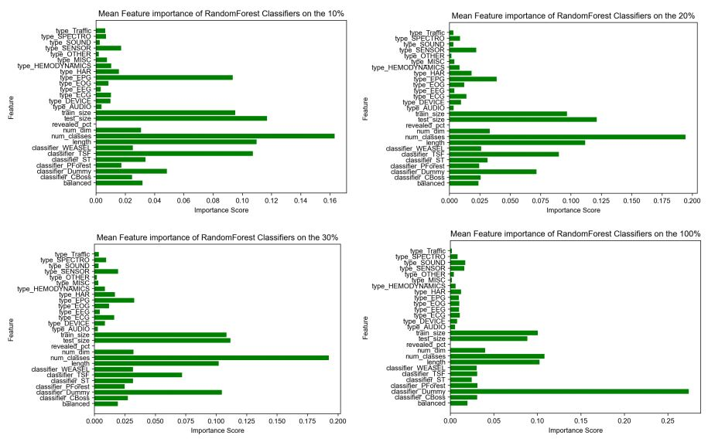
Recommender Results – Feature Importance

Slide 33
Conclusion - Testbed
In general, TSF is better than all other classifiers on early chunks
All classifiers are not significantly different from each other on full length
10% classifiers are not statistically different from the 100% classifiers based on F-score due to role of earliness
Beta value has great effect on results of testbed
No clear relation between data characteristics and performance of classifiers in early classification context

Slide 34
Conclusion - Recommender
Recommender tends to over estimate performance of classifiers
RMSE = 6.71% on 10% chunk but increases to 19.52% on full length
Regardless of the error, still recommends good classifiers
Baseline classifier has great effect on results of recommender
Recommender depends mainly on data set features for recomemdations

Slide 35
Future Work
Cover a broader spectrum of time series problem types
Use bespoke multivariate classifiers to learn relations between dimensions
Investigate understandability under the early classification context for classifiers like TSF and ST
More granular chunks and comparison across more chunks
Using a time series classifier as baseline in recommender

Slide 36
Thank you for your attention!
www.ovgu.de

Slide 37
Appendix
www.ovgu.de

Slide 38
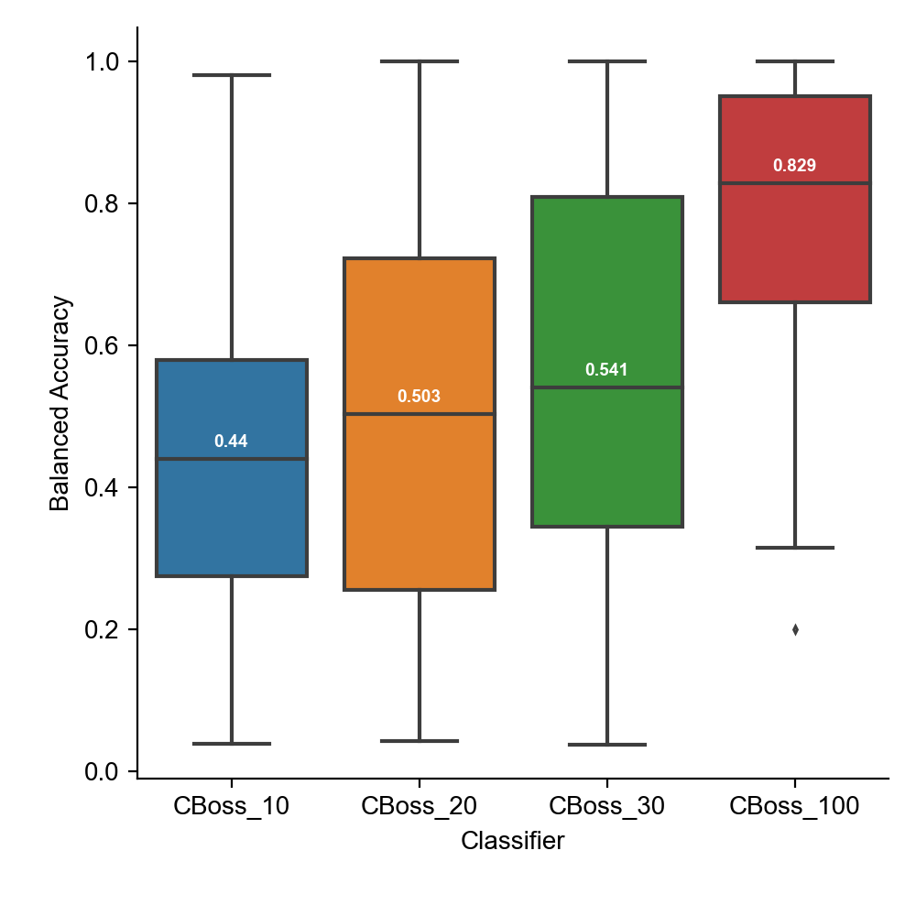
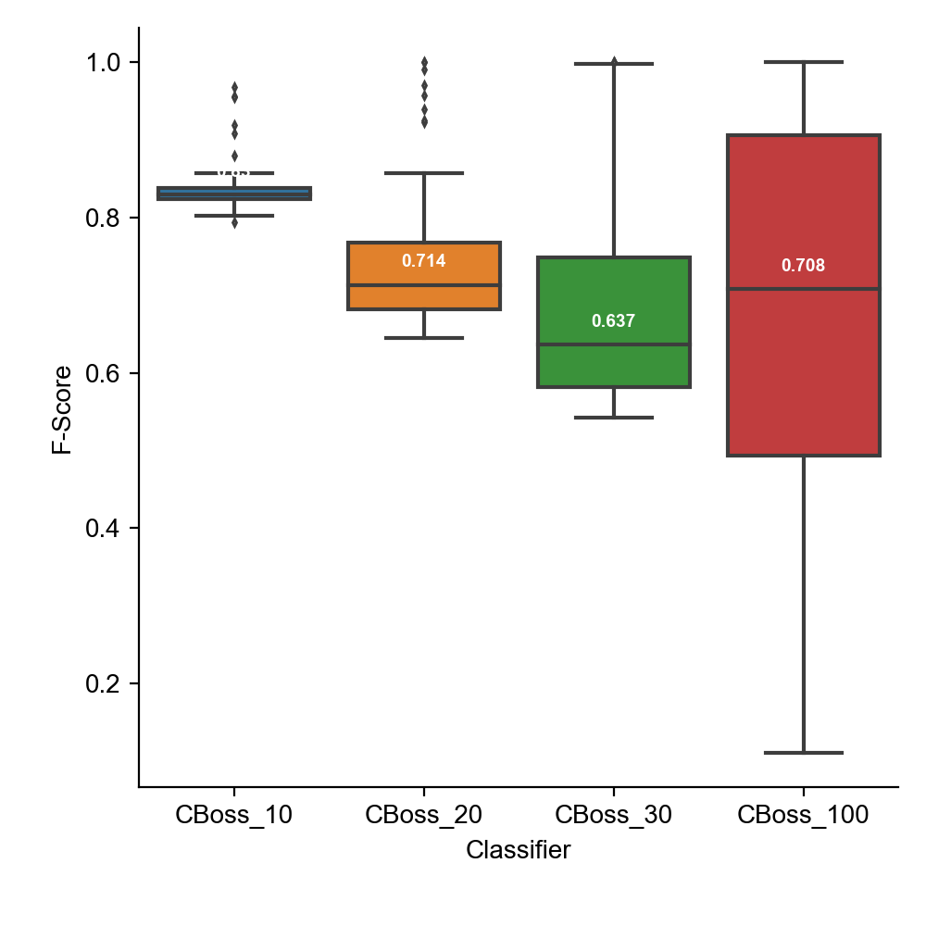
Harmonic Mean: Equal importance of accuracy and earliness

Slide 39
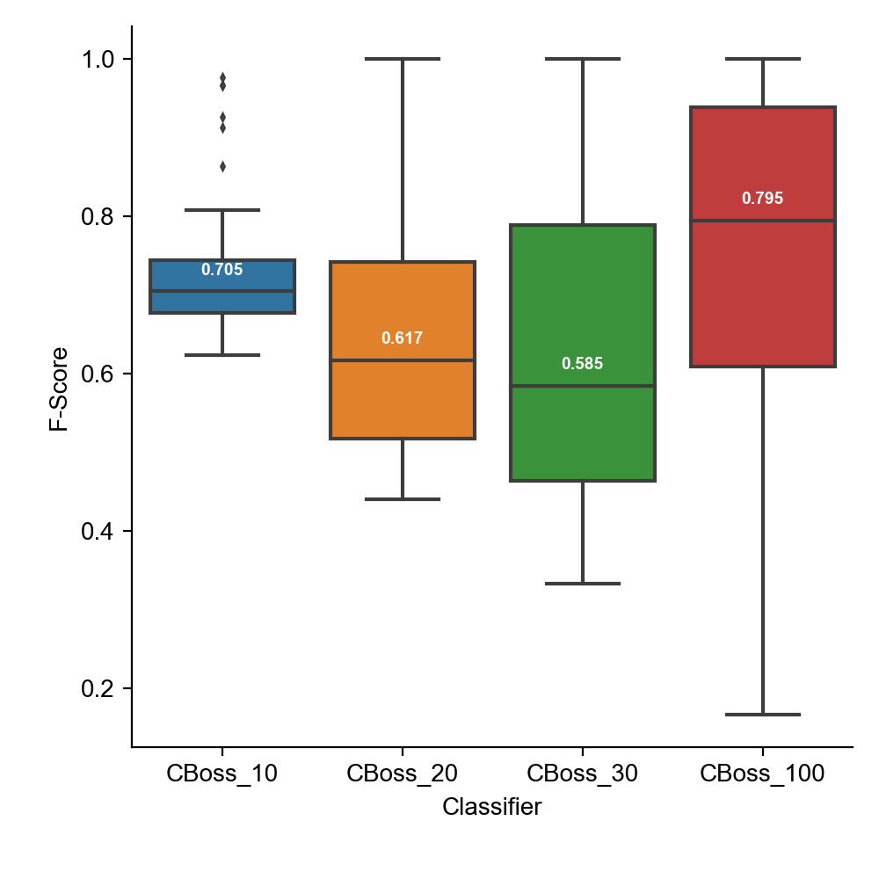
Accuracy twice important as earliness

Slide 40
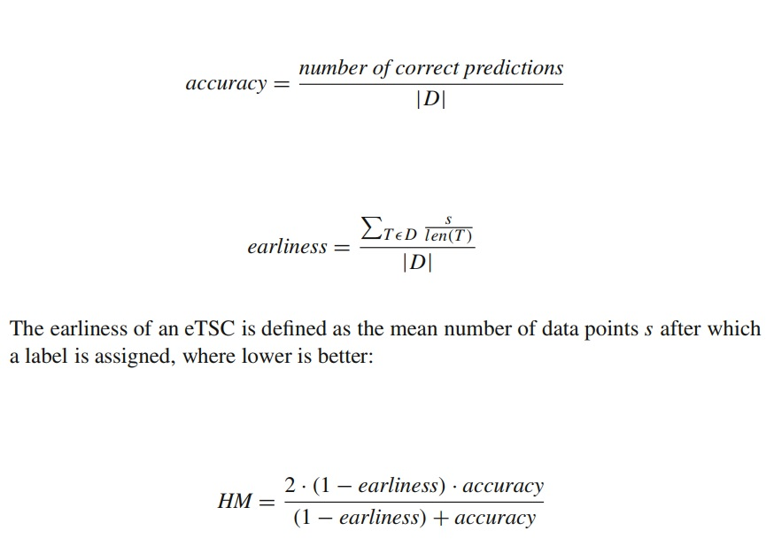

Slide 41
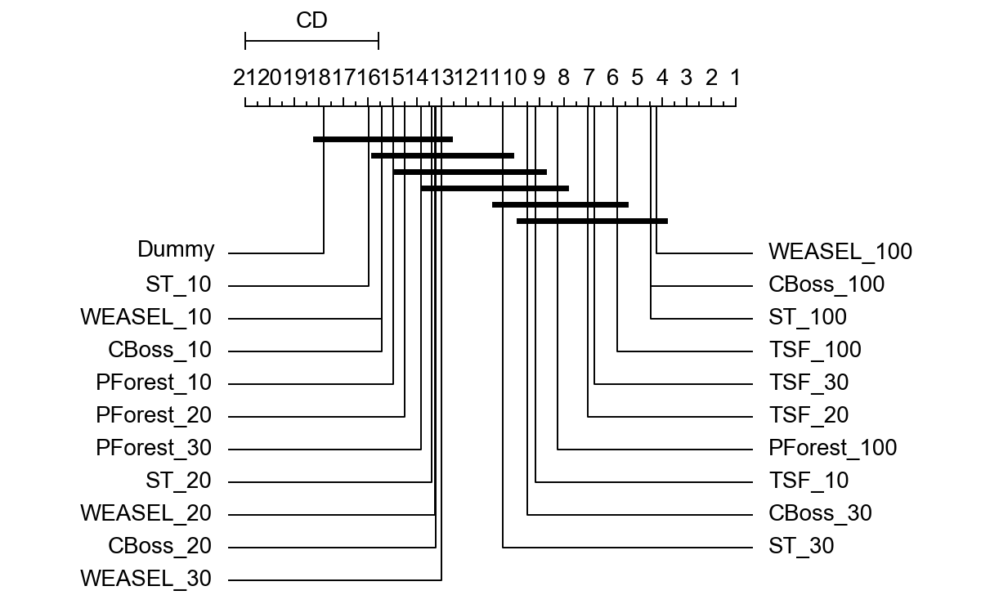
CD diagram All classifiers
(Balanced Accuracy)

Slide 42
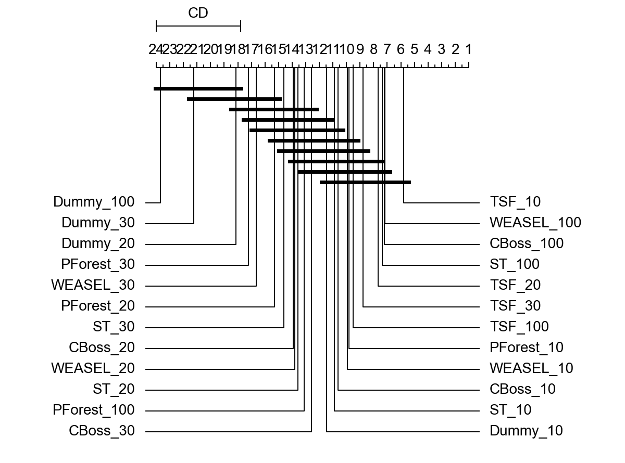
CD diagram All classifiers
(F-score)

Slide 43
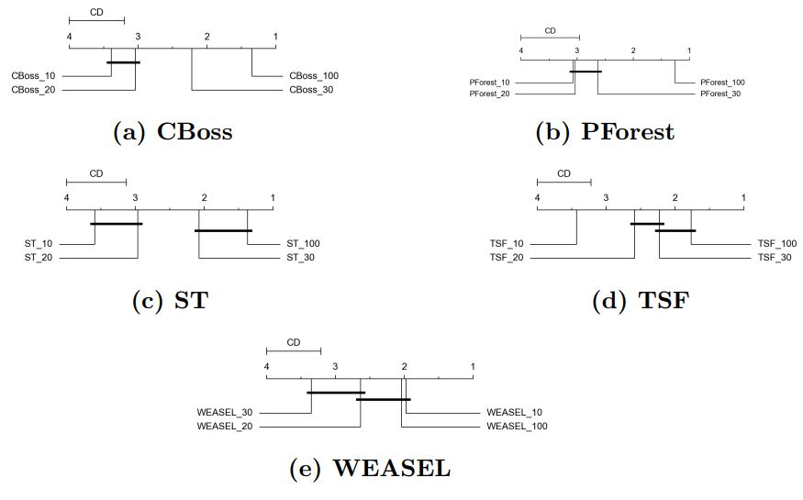
CD diagram within
(Balanced Accuracy)

Slide 44
CD diagram within
(F-score)

Slide 45
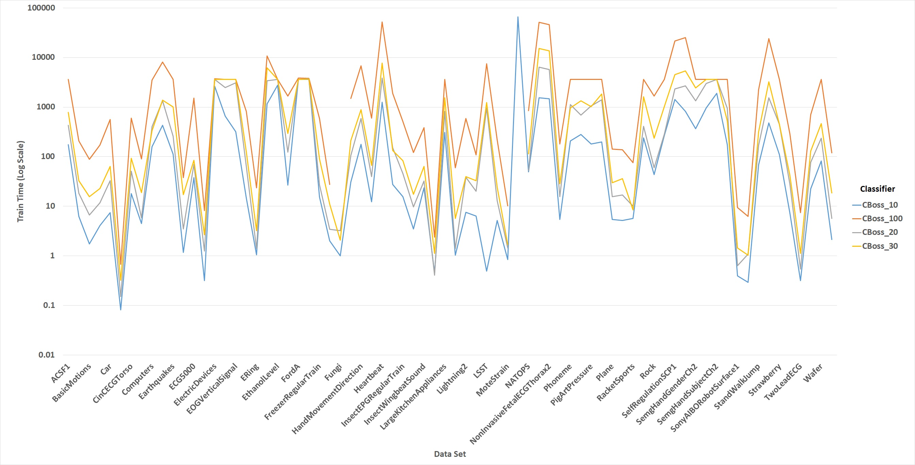
Runtime for CBoss

Slide 46
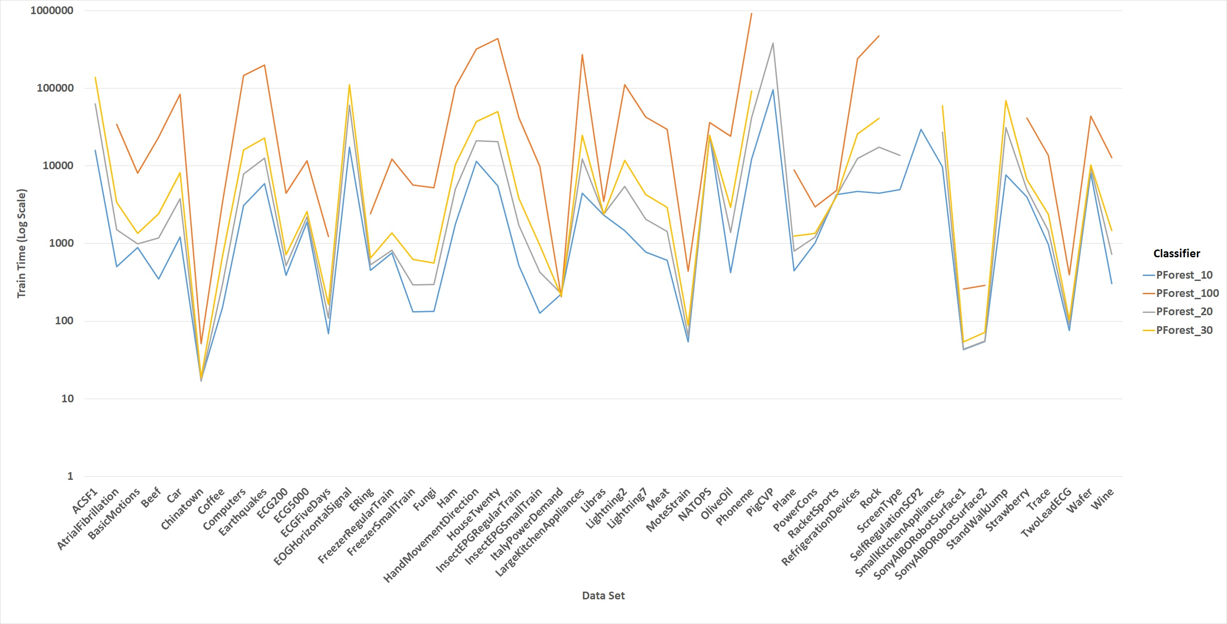
Runtime for PForest

Slide 47
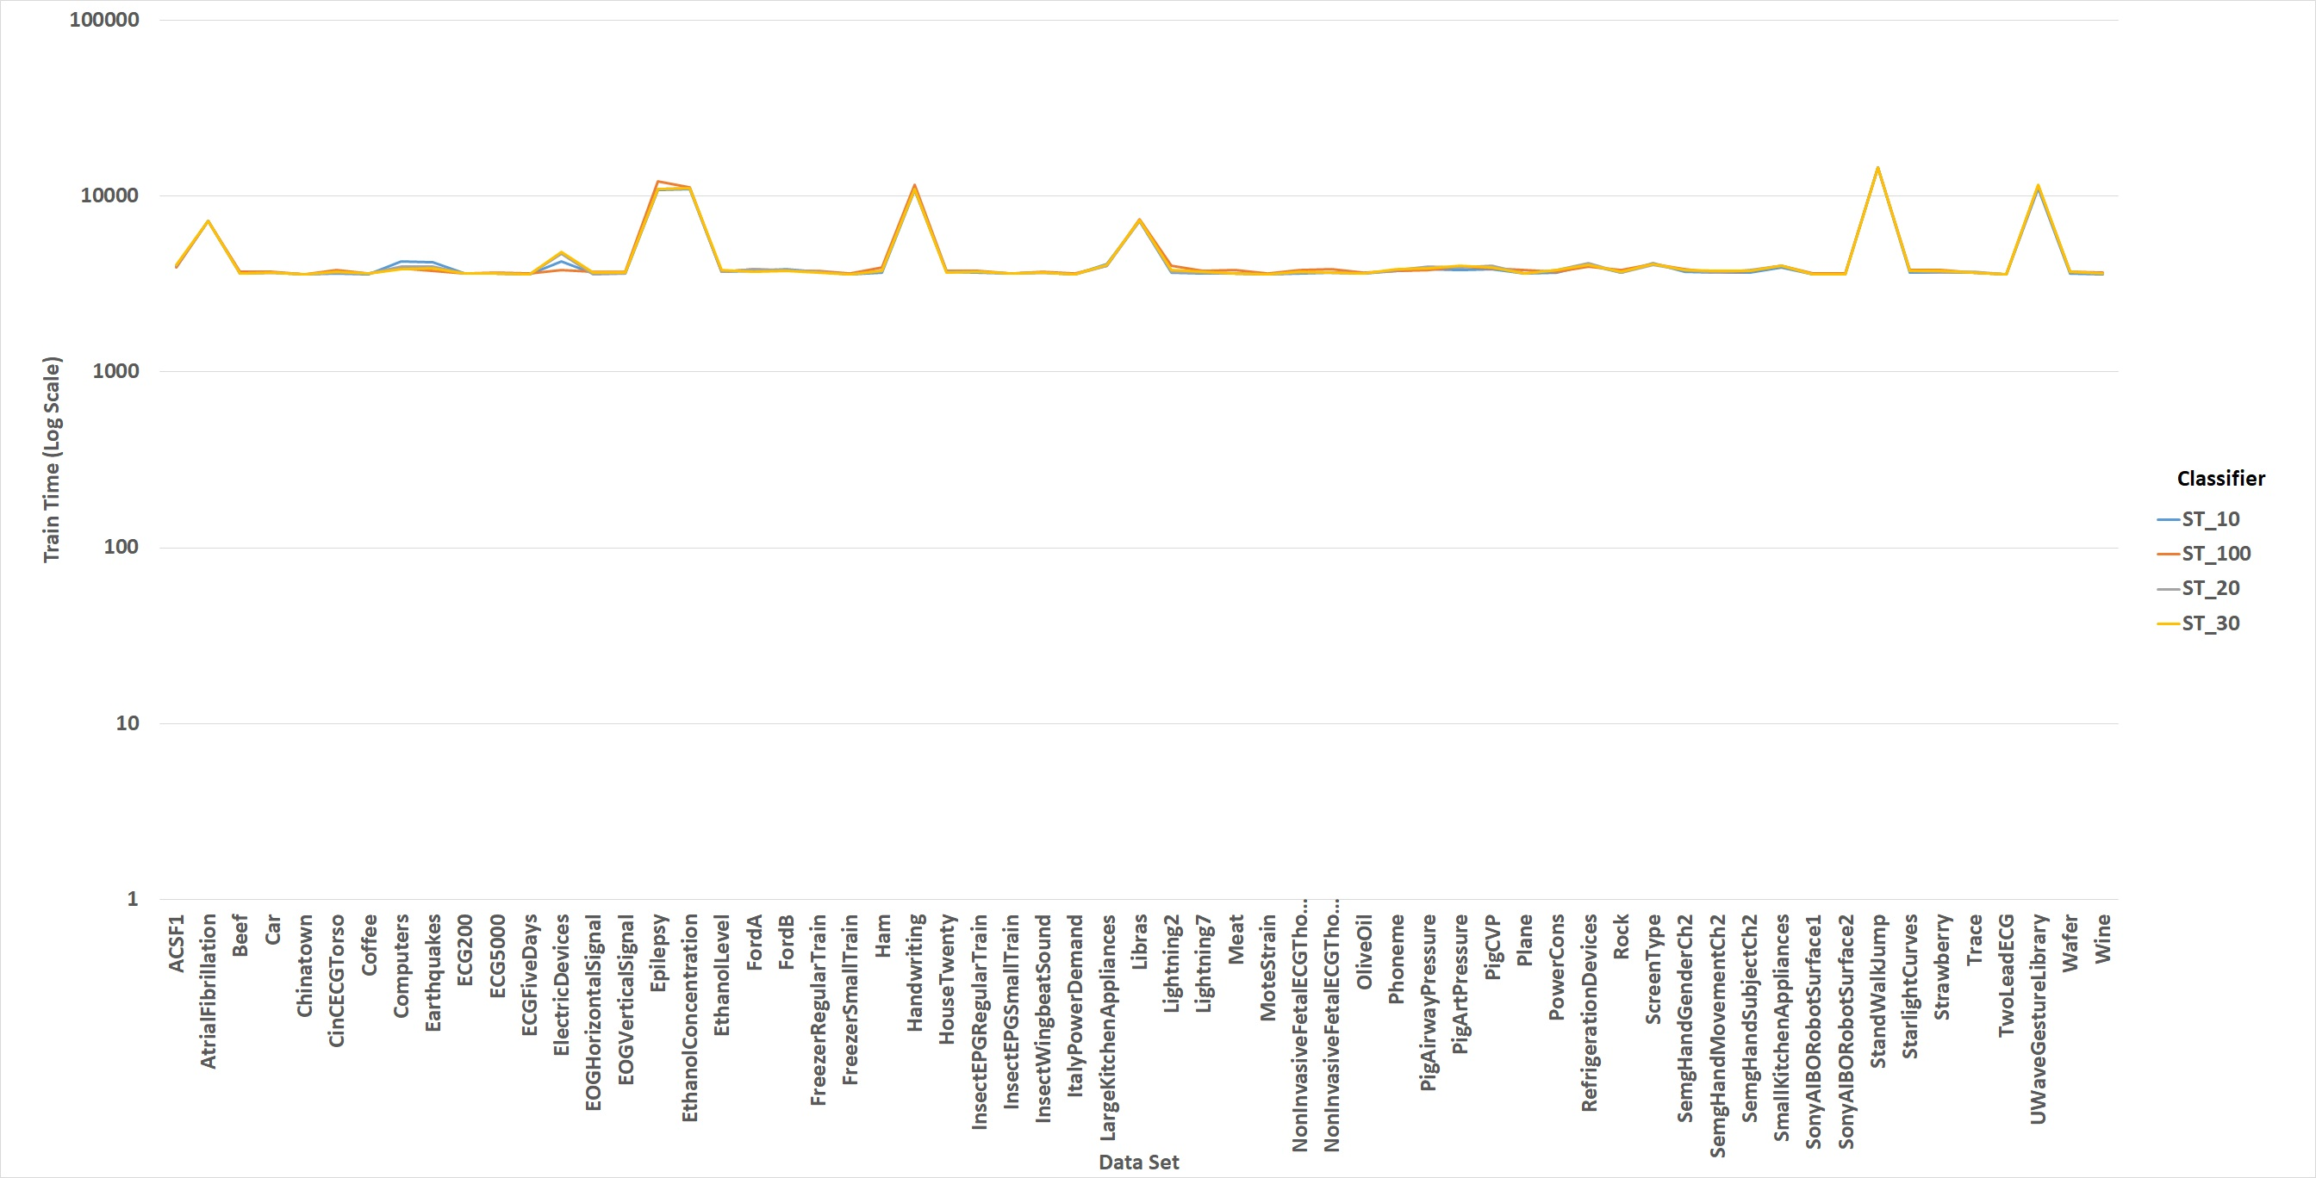
Runtime for ST

Slide 48
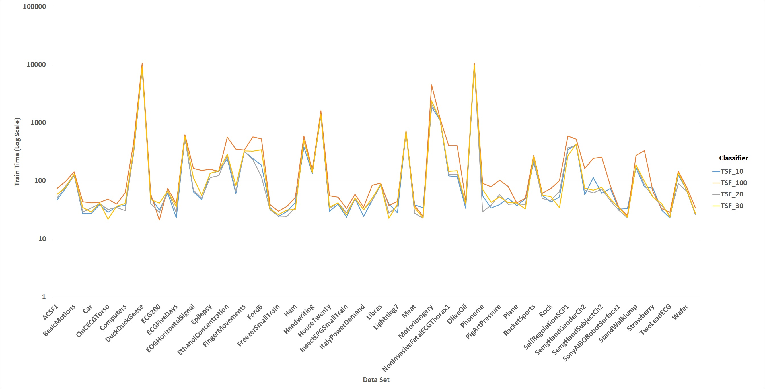
Runtime for TSF

Slide 49
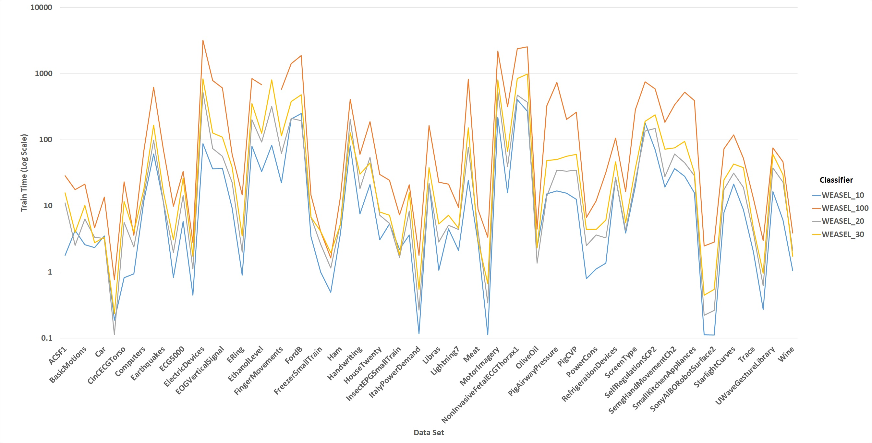
Runtime for WEASEL

Slide 50
References
[1] Bagnall, Anthony, et al. "The great time series classification bake off: a review and experimental evaluation of recent algorithmic advances." Data Mining and Knowledge Discovery 31.3 (2017): 606-660.Goals, Theses and Questions
[2] Fawaz, Hassan Ismail, et al. "Inceptiontime: Finding alexnet for time series classification." Data Mining and Knowledge Discovery 34.6 (2020): 1936-1962.Methodology
[3] Schäfer, Patrick, and Ulf Leser. "Fast and accurate time series classification with weasel." Proceedings of the 2017 ACM on Conference on Information and Knowledge Management. 2017.
[4] Fawaz, Hassan Ismail, et al. "Deep learning for time series classification: a review." Data Mining and Knowledge Discovery 33.4 (2019): 917-963.
[5] Ruiz, Alejandro Pasos, et al. "The great multivariate time series classification bake off: a review and experimental evaluation of recent algorithmic advances." Data Mining and Knowledge Discovery (2020): 1-49.
[6] Stefan, Alexandra, Vassilis Athitsos, and Gautam Das. "The move-split-merge metric for time series." IEEE transactions on Knowledge and Data Engineering 25.6 (2012): 1425-1438.
[7] Lucas, Benjamin, et al. "Proximity forest: an effective and scalable distance-based classifier for time series." Data Mining and Knowledge Discovery 33.3 (2019): 607-635.

Slide 51
References
[8] Deng, Houtao, et al. "A time series forest for classification and feature extraction." Information Sciences 239 (2013): 142-153.
[9] Lines, Jason, et al. "A shapelet transform for time series classification." Proceedings of the 18th ACM SIGKDD international conference on Knowledge discovery and data mining. 2012.
[10] Grabocka, Josif, et al. "Learning time-series shapelets." Proceedings of the 20th ACM SIGKDD international conference on Knowledge discovery and data mining. 2014.
[11] Schäfer, Patrick. "The BOSS is concerned with time series classification in the presence of noise." Data Mining and Knowledge Discovery 29.6 (2015): 1505-1530.
[12] Mori, Usue, et al. "Early classification of time series using multi-objective optimization techniques." Information Sciences 492 (2019): 204-218.
[13] Dau, Hoang Anh, et al. "The UCR time series archive." IEEE/CAA Journal of Automatica Sinica 6.6 (2019): 1293-1305.
[14] Bagnall, Anthony, et al. "The UEA multivariate time series classification archive, 2018." arXiv preprint arXiv:1811.00075 (2018).

